Slide 1
Automorphic distributions and analytic properties of L-functions
Stephen D. Miller
Rutgers University
Conference on Analytic Number Theory and Higher Rank Groups
Courant Institute, May 19-23, 2008
TexPoint fonts used in EMF.
Read the TexPoint manual before you delete this box.: AAAAAAAAAAA

Slide 2
Part 1: Classical Theory
Classical Automorphic Forms
L-functions for GL(2)
  Method of Integral Representations (Rankin-Selberg)
  Langlands-Shahidi Method
Big Questions:
  Temperedness
  GRH and zeroes on the line
  Lindelof
Methods to tackle analytic problems

Slide 3
Part 1: Classical Theory
Classical Automorphic Forms
L-functions for GL(2)
  Method of Integral Representations (Rankin-Selberg)
  Langlands-Shahidi Method
Big Questions:
  Temperedness
  GRH and zeroes on the line
  Lindelof
Methods to tackle analytic problems

Slide 4
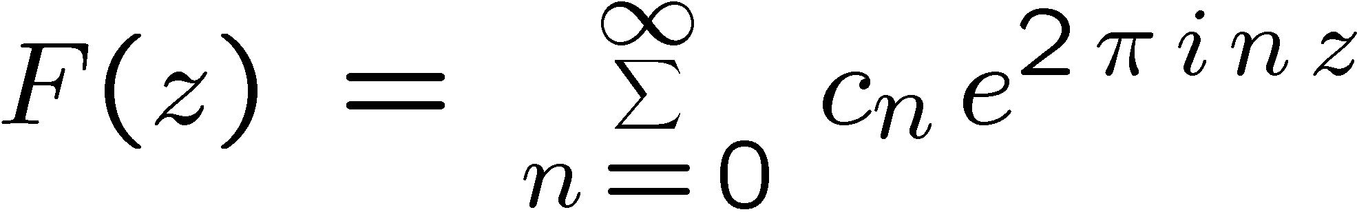
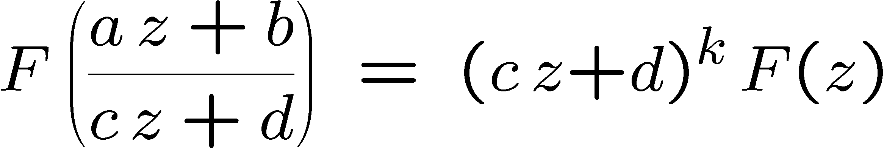
Classical Modular Forms
Holomorphic Functions on C which are invariant under Mobius transformations, according to a factor of automorphy.

Slide 5
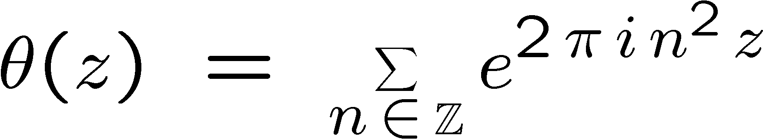
Some famous examples
Jacobi Theta function
is a weight ½ form for ¡₀(4)
Eisenstein series ∑(cz+d)^{-k}
Ramanujan ¢ form
Cusp form means vanishes in all cusps, or equivalently c₀=0 in all cusps.

Slide 6
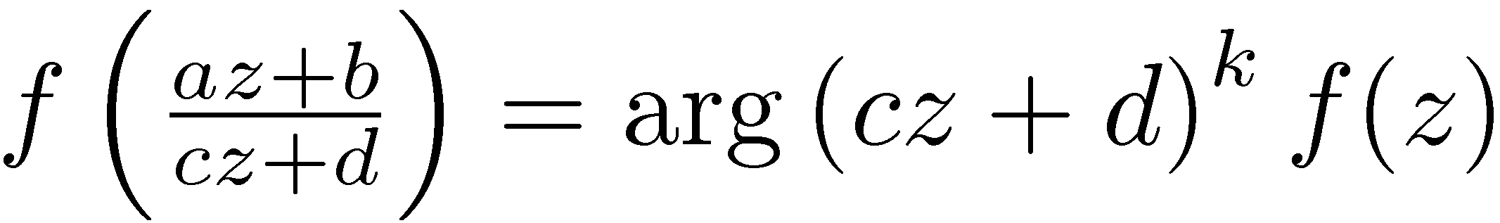
Maass Forms
Very similar, but not holomorphic: instead eigenfunctions of the Laplacian
Satisfy
(most notably with k=0).
Fourier expansion
in which ¢f = (1/4-º²)f

Slide 7
Part 1: Classical Theory
Classical Automorphic Forms
L-functions for GL(2)
  Method of Integral Representations (Rankin-Selberg)
  Langlands-Shahidi Method
Big Questions:
  Temperedness
  GRH and zeroes on the line
  Lindelof
Methods to tackle analytic problems

Slide 8
Their L-functions
Normalizations:
  In holomorphic case, write c_{n} = a_{n} n^{(k-1)/2}
  In Maass case assume a_{-n}= (-1)± a_{n}
  ( reduce to f(-x+iy) = § f(x+iy) )
Standard L-function is L(s,f) = ∑_{n>0} a_{n} n^{-s}
The interesting case is for cusp forms. It is then entire, and obeys a functional equation similar to Riemann ³(s)=∑ n^{-s}:
(this is called a completed L-function)

Slide 9
Hecke and Maass’ integral representations
Hecke’s idea: for SL(2,Z) at least one has that y^{k/2}f(iy)=y^{-k/2}f(i/y), and so the Mellin transform
will capture that symmetry.
Term by term computation
Maass: same thing, but different archimedean integral which luckily is also computible explicitly in terms of ¡-functions.

Slide 10
Eisenstein series and
Langlands-Shahidi
Non-holomorphic Eisenstein series
Has Functional equation relating s and 1-s similar to ³(s)’s (but doesn’t assume it!).
Has Fourier expansion with reciprocals of ³ as coefficients.
Putting it together: a new proof of functional equation (and even all analytic properties) of ³(s).

Slide 11
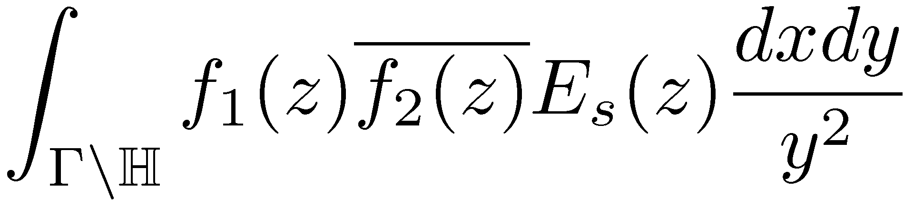
Rankin-Selberg GL(2)xGL(2) L-function
Rankin and Selberg independently noticed in the late 1930s that the integral
is meromorphic
  and has a functional equation inherited from the Eisenstein series.
  Also, it can be computed in terms of the tensor product L-function
Thus, a functional equation and analytic continuation of the “Rankin-Selberg” L-function

Slide 12
Part 1: Classical Theory
Classical Automorphic Forms
L-functions for GL(2)
  Method of Integral Representations (Rankin-Selberg)
  Langlands-Shahidi Method
Big Questions:
  Temperedness
  GRH and zeroes on the line
  Lindelof
Methods to tackle analytic problems

Slide 13
Big Questions about L-functions
And what can these methods of obtaining them say about them?
Is there a need for other methods?
  Yes, what are they?

Slide 14
Big analytic questions:
Temperedness
Ramanujan’s conjecture – the normalized coefficients a_{n} are essentially bounded:
Selberg’s conjecture – the eigenvalue ¸ of a Maass form satisfies ¸ ¸ ¼.
Because of Hecke operators, Ramanujan’s conjecture reduces to showing |a_{p}|· 2.
  Convenient to parametrize a_{p} = ®_{p}+®_{p}⁻¹
Thus if ®_{p} = p^{iºp}, both statements assert <º_{p} or <º = 0.
The parameters º_{p} and º have natural representation theoretic meaning.
Not surprisingly, similar progress on each:
|<º_{p}| · 7/64 (Kim-Sarnak).

Slide 15
Big analytic questions:
GRH
Riemann conjectured that the zeroes of the completed Riemann ³ function have real part ½.
The Gamma factors throw in extra, understood zeroes.
Same conjecture applies to general L-functions.
An analogous bound to the previous slide for the Real part of the zeroes seems completely out of the question currently.
  Hard to rule out even Landau-Siegel zeroes: real zeroes very close to 1.

Slide 16
Big analytic questions:
Zeroes on the line
Instead, people try to solve implications of GRH. This one doesn’t have many implications, but the next one has several.
Hardy and Littlewood showed ³ has infinitely many zeroes on the line ½+it.
Selberg proved a positive proportion:
(10⁻⁵⁰ > 0)
This is a GL(2) phenomenon (covering GL(1) by a correspondence). No results at all outside GL(2).

Slide 17
Big analytic questions:
Lindelof, Subconvexity
This has several important implications and is a fundamental problem in its own right.
RH ) ³(1/2+it) ¿_{²} t² (known as Lindelof Hypothesis).
Can ask about other L-functions.
General “convexity” bound using Phragmen-Lindelof theorem: ³(1/2+it) ¿_{²} t^{¼ +²}.
Beating this exponent ¼ by any amount is termed “subconvexity”, and an important challenge for general L-functions.
  Often it completely resolves an analytic problem by showing a remainder term is smaller than a main term.

Slide 18
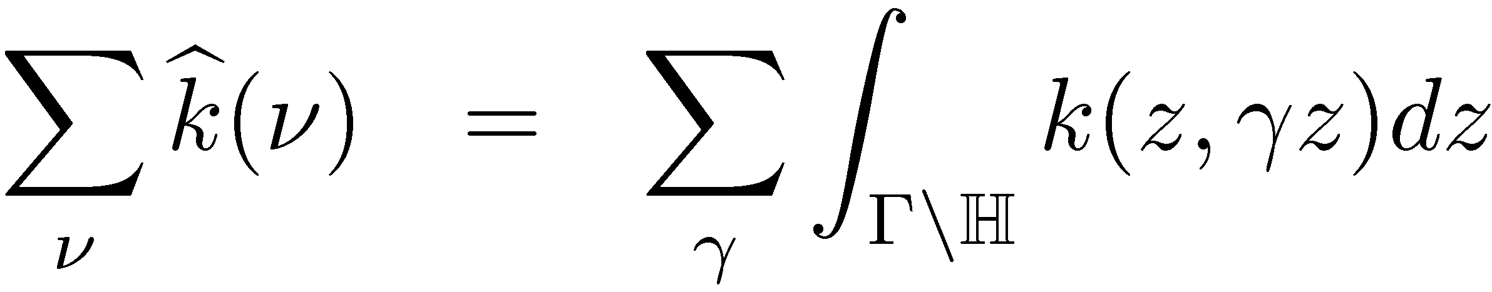
Major techniques: summation formulas
Poisson
Voronoi
Selberg Trace Formula
Kuznetsov
  Sums of a_{f}(n)a_{f}(m) over holomorphic f given by a sum of Kloosterman sums, but weighted by L² norm
Petersson
  Similar to Kuznetsov, but for Maass forms.
Summation formulas are important because trivial bounds on one side can give nontrivial information about the other side (sometimes both ways!)

Slide 19
Part II: Higher Rank
Definition of automorphic forms
Relation to classical theory
Automorphic Representations
Langlands’ L-functions

Slide 20
Part II: Higher Rank
Definition of automorphic forms
Relation to classical theory
Automorphic Representations
Langlands’ L-functions

Slide 21
General automorphic L-functions all come from GL(n)
Let G=GL(n,R) and ¡=GL(n,Z) or a congruence subgroup (means finite index if n>2).
Consider functions on ¡nG, e.g. L²(¡nG)
We then seek to break them into smaller pieces, like we did before with weights and eigenvalues

Slide 22
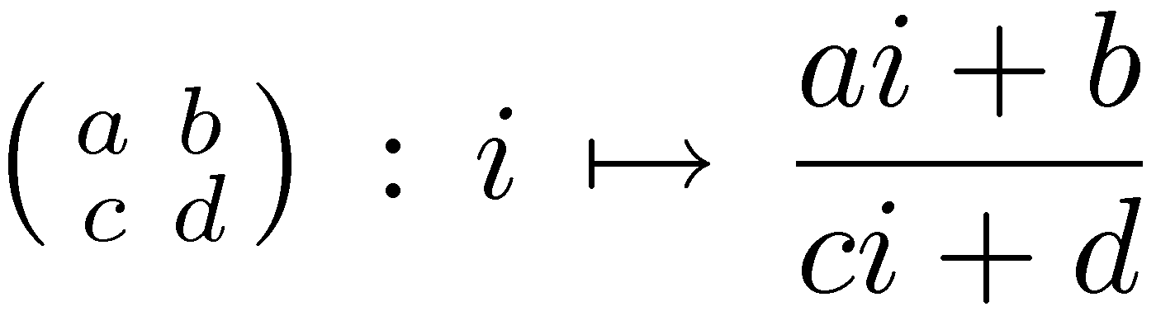
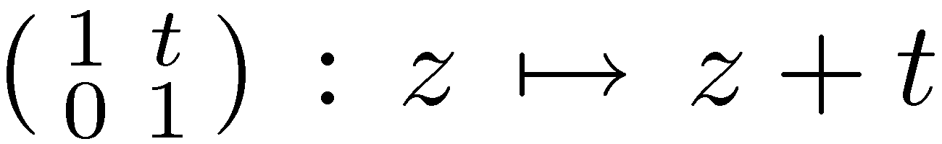
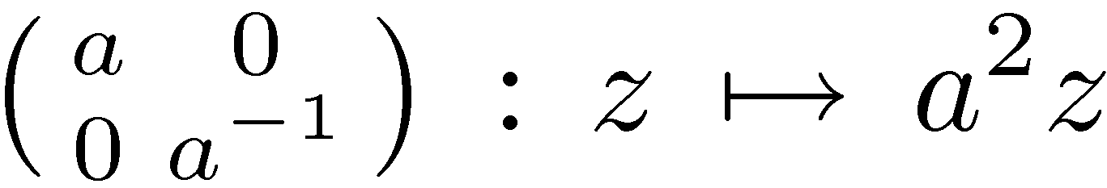
Need to get from H to GL(2)
But first, we need to explain how to convert from functions on H to G = SL(2,R).
Key observation: G acts transitively on H, e.g.
Three important subgroups of G act nicely:
  N = unit upper triangular
  A = diagonal
  K = SO(2,R) -- stabilizes i
Thus H is isomorphic to the quotient G/K

Slide 23
Automorphic function on ¡\G
N, A, and K all generalize to GL(n):
  N = unit upper triangular
  A = diagonal
  K = orthogonal
Classical approach: look at the symmetric space G/K, positive definite matrices. Formulas are messy!
Invariant approach: stay on G

Slide 24
Notion of Automorphic Representation
Consider the vector space L²(¡\G)
The group G acts on it by right translation:
This action is highly reducible, for example constant functions are an irreducible subspace.
An irreducible subspace is called an automorphic representation.

Slide 25
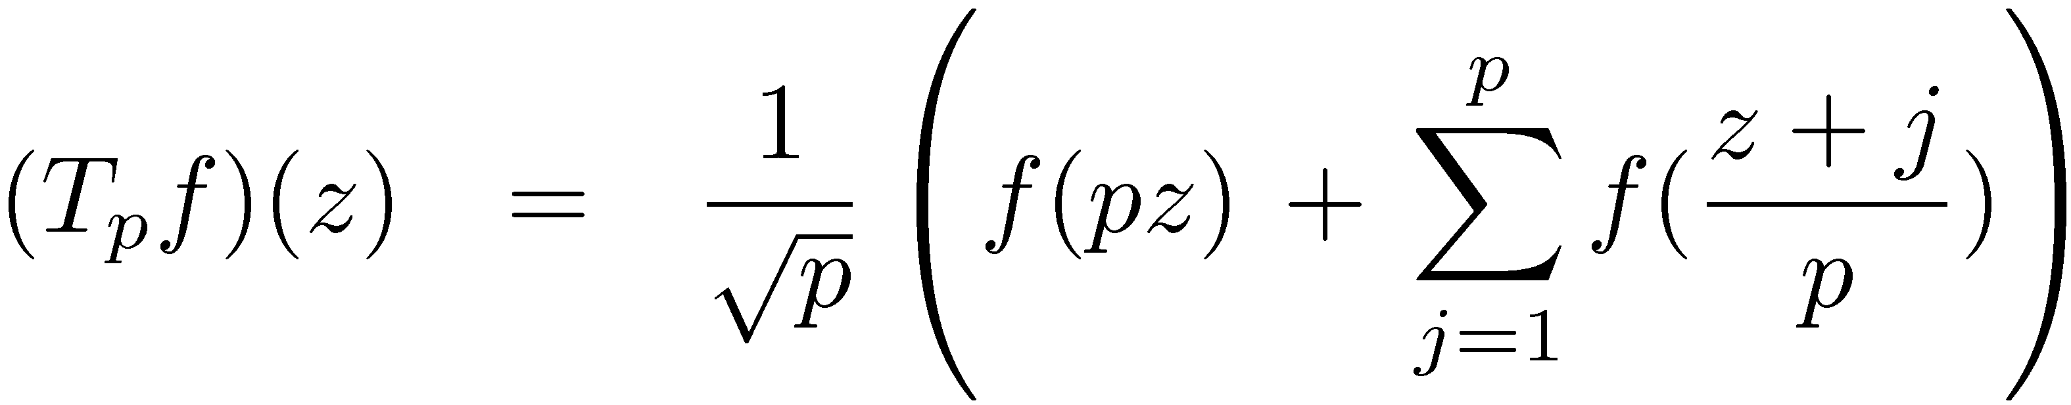
Hecke operators
Classical averaging operator
In terms of G, averaging left translates a function by certain rational matrices.
These matrices respect ¡ and map automorphic forms to automorphic forms
Generalizations work for GL(n)
These operators commute with ½(h), so act as scalars on irreducible spaces. Their eigenvalues are used to make L-functions.

Slide 26
Part II: Higher Rank
Definition of automorphic forms
Relation to classical theory
Automorphic Representations
Langlands’ L-functions

Slide 27
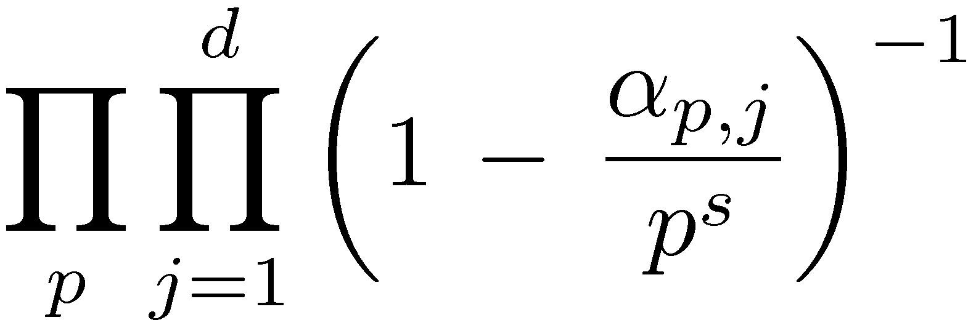
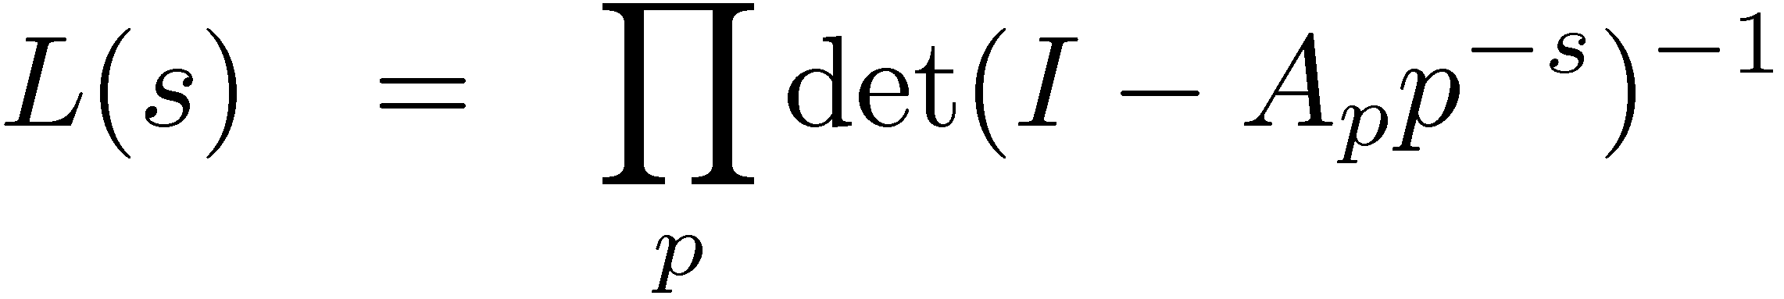
Definitions of standard L-functions
The standard L-function of an automorphic form on GL(d) is a Dirichlet series L(s) = ∑_{n>0} a_{n} n^{-s} which factors as a degree d Euler product:
The ®_{p,j} parameterize the Hecke action at most primes (but it gets messy at the others).
This data is not really ordered by j, so think of it as a set {®_{p,1} , ®_{p,2} , …, ®_{p,d} } or better yet as a diagonal matrix A_{p}.
Thus

Slide 28
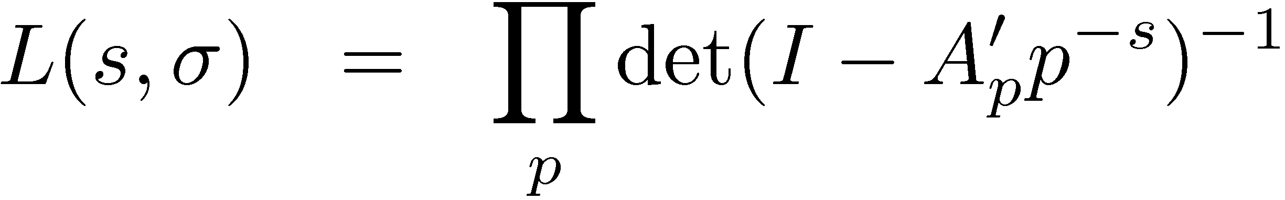
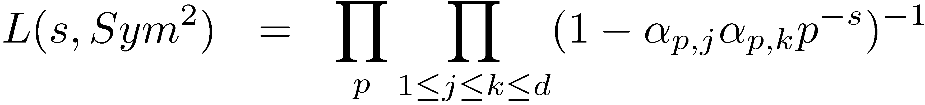
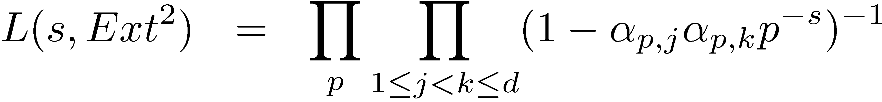
Definitions of other Langlands L-functions
Langlands general paradigm: (for “good primes”)
  Fit the matrix A_{p} into a group ^{L}G
  Take a representation ¾: ^{L}G! GL(m)
  Let A_{p}’ = ¾(A_{p})
  Define
In practice, it has more to do with symmetric combintations of {®_{p,j}} than with groups.
  Symmetric Square
  Exterior Square
  Rankin-Selberg Tensor Product: ®_{p,j}£¯_{p,k}

Slide 29
They are all supposed to be standard L-functions
Langlands conjectured that all his L-functions are standard L-functions of automorphic forms on some GL(m,R) for a congruence subgroup ¡.
Thus, their analytic properties would come from the those:
And GL(n,Z)\GL(n,R) + covers are thus the fundamental analytic objects to study.
The end

Slide 30
Notion of Automorphic Representation

Slide 31
What is a representation?
(π,V) is a representation of a group G means that π:G! GL(V) is a homomorphism
Often one adds a continuity assumption
Unitary representation:
  If V has an inner product, π leaves it invariant.
Dual representation π’ acts on linear functionals V’:
  [π’(g)λ](v) = λ(π(g⁻¹)v)
  If π is unitary, so is π’.

Slide 32
Adding topology
Now assume G is locally compact and V is a topological vector space.
We further insist that π be continuous
Unitary: V must be a Hilbert space
Irreducible: V contains no proper closed invariant subspaces.
Important example: the subspace V¹ ½ V of smooth vectors:
  V¹ := {v | g  π(g)v is smooth}
  V¹ is an invariant subspace
  Often V¹ is dense in V

Slide 33
L²(ΓnG) and central characters
Recall before that we could view classical automorphic forms as functions on ΓnG.
When G = SL(2,R), they were in L²(ΓnG).
However, if we used G = GL(2,R), then ΓnG has infinite volume because of the center Z={nonzero scalar matrices}.
To look modulo the center, we use central characters ω: Z  C*. These must be unitary.
We look at L_{ω}²(ZΓnG) = {f(zγ g)=ω(z)f(g), |f|² integrable over the quotient}.
  a Hilbert space under the usual inner product.

Slide 34
L_{ω}²(ZΓnG) as V
Words of wisdom:
  “Anytime someone asks you to give them a representation of a group, you can always say ‘the regular represenation’” – David Kazhdan
The right regular representation (ρ,V) is given by [ρ(g)f](h) = f(hg).
Likewise, the left regular representation is given by [λ(g)f](h) = f(h⁻¹g).
Since we modded out by Γ on the left, ρ acts on V in our setting, but λ does not. However, it gets used in other contexts.
Clearly ρ preserves the L² inner product and qualifies as a unitary representation of G.

Slide 35
Automorphic Representation
An irreducible subrepresentation of L_{ω}²(ZΓnG) under ρ.
That means this representation is a unitary, irreducible representation (UIR) (π,W) of G.
  We say (π,W) occurs in L_{ω}²(ZΓnG).
Its smooth vectors are precisely those equivalences classes containing a smooth function.
A given abstract UIR of G can occur many different ways, in different irreducible subspaces.
If (π,W) occurs in L_{ω}²(ZΓnG), then its dual (π’,V’) occurs in L²_{ω}⁻¹ (ZΓnG).

Slide 36
How to make an invariant subspace
If you start with some function f 2 L_{ω}²(ZΓnG), you can make many other functions f by right-translation (i.e. applying ρ(g)f for various values of g).
  For this discussion we might as well assume f sits inside an irreducible subrepresentation.
The span of {ρ(g)f | g 2 G} is of course invariant under ρ.
However, it is not a closed subspace.
You can also smear out several of these translates together: take
for some smooth function ψ of compact support.
The collection of these {ρ(ψ)f | ψ 2 C¹_{c}(G)} = V¹. Its closure is the full automorphic representation.

Slide 37
Automorphic Distributions

Slide 38
Automorphic Embeddings
Start with an automorphic representation W, as irreducible subspace of L_{ω}²(ΓnG).
W is equivalent to other models (π,V) of the same UIR of G.
So there is a G-equivariant map
j : V ! L_{ω}²(ΓnG)
which intertwines (π,V) and (ρ,W):
j(π(g)v) = ρ(g)j(v).
The map j also respects different globalizations of G:
  For example the smooth vectors V¹ get sent to smooth functions on ΓnG.
The subject of automorphic distributions is in some sense about how j acts on V⁻¹.

Slide 39
Setting up the distribution
Actually switch from W to the dual W’, which sits inside
L²_{ω}⁻¹(ZΓnG).
Form a linear functional τ on V’¹ by evaluating j(v) @ e:
τ(v) = j(v)(e).
The reason we need to look at V’¹ and not just V is because L² functions are not literally functions, but equivalence classes, and hence do not have pointwise values.
This linear functional is obviously Γ-invariant, and since it is dual to smooth functions actually is a distribution vector for (V’)’ [ = V in a Hilbert space]:
τ 2 (V⁻¹)^{Γ}.
This lone object \tau carries with it all the information needed to reconstruct the automorphic representation (by group translation).
  This implicitly assumes the model is understood (see next slide).

Slide 40
Concrete ways to look at τ
The distribution τ can have many guises, all depending on what model is taken for V’.
Silly example: if you take the actual automorphic realization W’ as the model V’, then j is just the delta function at the identity.
However, if the model for V’ is highly nonarithmetic, then τ must necessarily contain all the arithmetic.
In the latter situation (which we pursue typically) \tau concisely encodes all information about the automorphic representation.
We will look at particular models later.

Slide 41
Whittaker Functions

Slide 42
Classical Theory
Holomorphic cusp forms have q-expansions
∑_{n¸ 0} c_{n} q^{n}, q=exp(2πiz).
Maass forms have similar Fourier expansions
∑_{n≠ 0} a_{n} y^{1/2} K_{ν}(2π|n|y)exp(2πinx).
The main difference is that the special function changed from exp(-2πny) to y^{1/2} K_{ν}(2π|n|y).
The special function is determined by a second order differential equation.
For Maass forms of different weights, this is known as a Whittaker function.

Slide 43
General Whittaker functions
One way to obtain these functions directly from the cusp form is by integration:
W(y) = s₀¹ φ(x+iy) exp(-2πix)dx
If the first Fourier coefficient a₁=0, then take a higher coefficient instead. In the classical SL(2,Z) setting, one must be nonzero.
In group framework, this corresponds to
W(g) = s _{N(Z)nN(R)} φ(ng) ψ(n)⁻¹ dn,
where N=nilpotent subgroup and ψ=additive character of N(R) which is trivial on N(Z).

Slide 44
Whittaker models
The map just given φ(g)! W(g) works on the left, so that one can still apply ρ to W.
If we consider W = {W obtained this way} it is therefore a representation space for the automorphic representation.
Moreover, evaluation at the identity again yields an interesting linear functional:
  Map Λ: φ ! W(e)
  Then Λ(π(n)v) = ψ(n)v for any vector v in the representation space (v = φ and π=ρ here).
A linear functional on a representation (π,V) having that property is called a Whittaker functional.
Given a Whittaker functional, one can create a representation space as follows:
  Given v, create the function W_{v}(g) = Λ(π(g)v)
  In the previous context, this recovers W 2 W as before.
NOTE: all these notions depend on the choice of nontrivial additive character ψ.

Slide 45
Generic Representations
Those which have a nonzero Whittaker functional, i.e. can be intertwined to a Whittaker model.
An automorphic representation has no Fourier coefficients for ψ unless it is generic.
Theorem (PS,Shalika – 70’s): all automorphic forms for G = GL(n,R), Γ = congruence subgroup of GL(n,Z) are generic.

Slide 46
Adelic versions of Whittaker
Uncharitable Summary: write Fourier coefficients a_{n} as a function of n, and call it representation theory ☺
This is actually not unreasonable, since the Hecke operators interact with the coefficients in an interesting way, and this is poorly understand when there is nontrivial level.
This way the connection between Hecke action and Fourier coefficients gets nailed down.
First factor a_{n} as a product of a_{pk}, and essentially define W_{p}(diag(pk,1))=a_{pk}.

Slide 47
Automorphic distributions and analytic properties of L-functions
(Lecture 3)
Stephen D. Miller
Rutgers University
Conference on Analytic Number Theory and Higher Rank Groups
Courant Institute, May 19-23, 2008
(Joint work with Wilfried Schmid, Harvard University)
TexPoint fonts used in EMF.
Read the TexPoint manual before you delete this box.: AAAAAAAAAAA

Slide 48
Automorphic Distributions
Suppose G = real points of a split reductive group defined over Q.
Γ ½ G = arithmetically defined subgroup
  e.g. Γ = SL(n,Z) ½ SL(n,R)
  or Γ = GL(n,Z) ½ GL(n,R) (if center taken into account appropriately)
An automorphic representation is an embedding of a unitary irreducible representation j : (π,V) ! L²(ΓnG)
Under this G-invariant embedding j, the smooth vectors V¹ are sent to C¹(ΓnG).
Consider the “evaluation at the identity” map
  τ: v  j(v)(e)
  which is a continuous linear functional on V¹ (with its natural Frechet topology).
  Upshot: τ 2 ((V’)⁻¹)^{Γ} − a Γ-invariant distribution vector for the dual representation.
Because (π,V) and (π’,V’) play symmetric roles, we may switch them and henceforth assume τ 2 (V⁻¹)^{Γ}.

Slide 49
Some advantages
The study of automorphic distributions is equivalent to the study of automorphic forms.
It appears many analytic phenomena are easier to see than in classical approaches:
  For example,
However, this technique is not well suited to studying forms varying over a spectrum, just an individual form.
Whittaker expansion
(messy)
Summation Formulas
Hard
Automorphic form
Hard
Easy?
Easy?
L-functions
Easy?

Slide 50
The line model for GL(2,R)
Here N is one dimensional, isomorphic to R.
NÅ Γ ' Z
So τ 2 C⁻¹(ZnR) is a periodic distribution, hence has a Fourier expansion
  τ(x) = ∑_{n2 Z} c_{n} e(nx)
with e(x) = e^{2π i x} and some coefficients c_{n}.
The G-action in the line model is
Therefore:

Slide 51
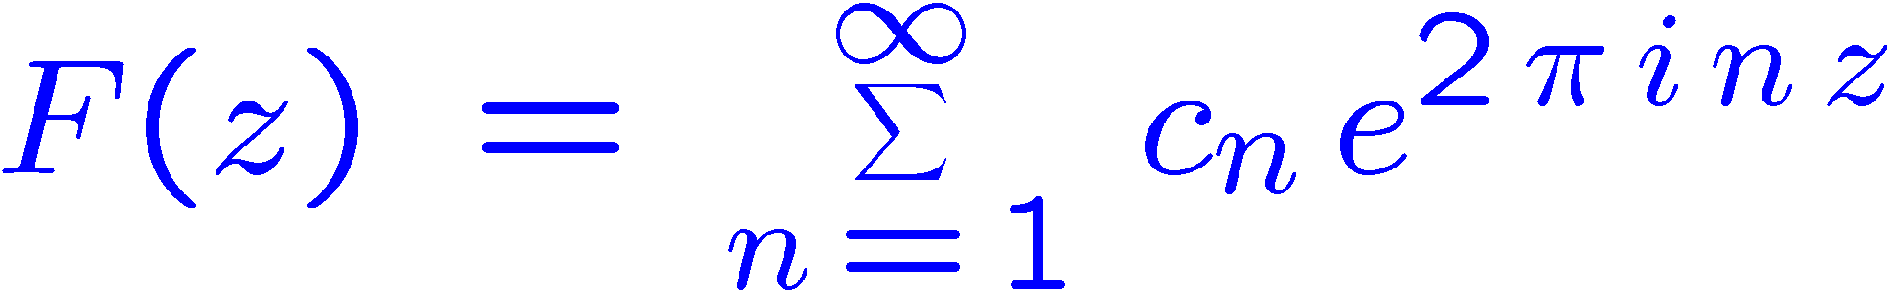
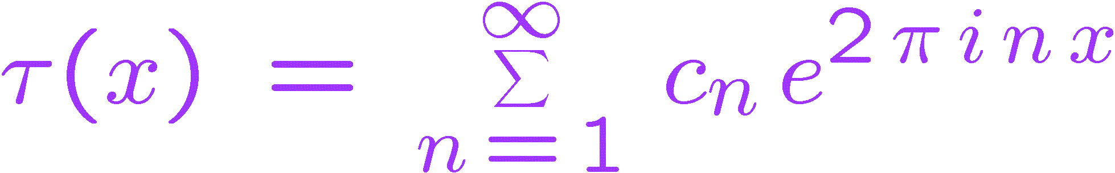
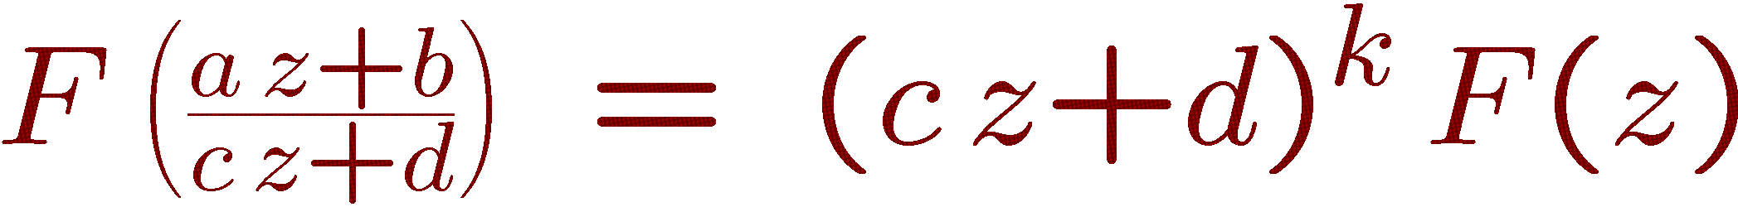
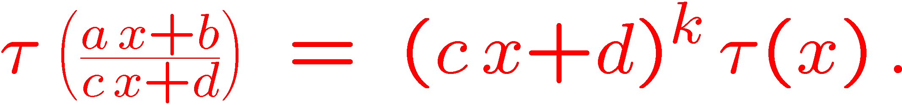
Forming distributions from holomorphic forms
In general start with a q-expansion
Restrict to x-axis:
Here c_{n} = a_{n} n^{(k-1)/2}, where k is the weight.
The distribution τ inherits automorphy from F :
If
then

Slide 52
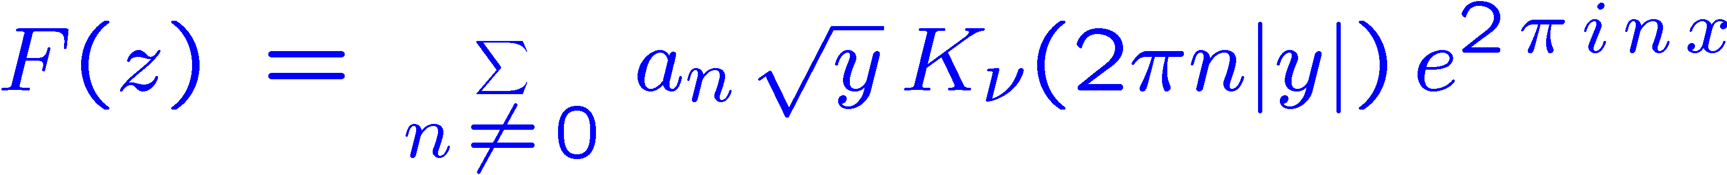
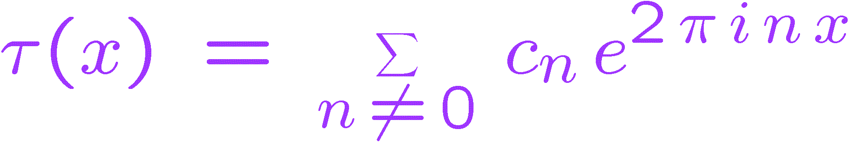
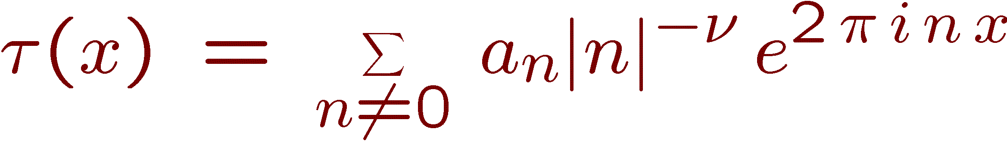
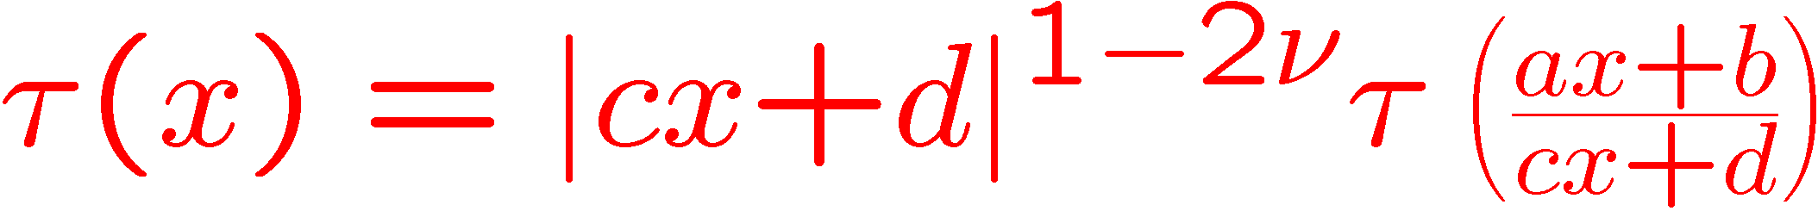
For Maass forms
Start with classical Fourier expansion
Get boundary distribution
where again c_{n} = a_{n} n^{-ν}
Note of course that when ν = (1-k)/2 the two cases overlap. This corresponds to the fact that the discrete series for weight k forms embeds into V_{ν} for this parameter.
Upshot: uniformly, in both cases get distributions
satisfying

Slide 53
What can you do with Boundary value distributions?
Applications include:
  Constructing L-functions
  Summation Formulas
  Cancellation in sums with additive twists
  Implication to moments
  Existence of infinitely many zeroes on the critical line
All of these give new proofs for GL(2), where these problems have been well-studied.
However this method gives new applications on GL(n).

Slide 54
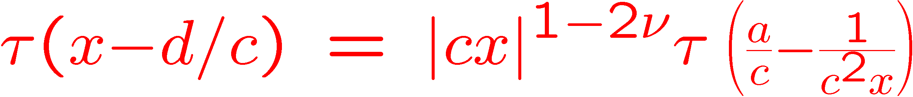
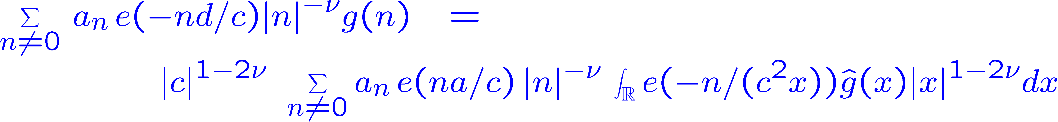
Distributions are born to be integrated
Start with
Integrate against g^(x), and get
This is the Voronoi Summation Formula

Slide 55
Summation Formulas
Voronoi summation formula for GL(2): if
  f(x) is a Schwartz function which vanishes to infinite order at the origin
  a_{n} are the coefficients of a modular or Maass form for SL(2,Z)
  a, c relatively prime integers,
then
where
This formula has many analytic uses for dualizing sums of coefficients (e.g. subconvexity, together with trace formulas).
It can be derived from the standard L-function (if a=0), and from its twists (general a,c). The usual proofs involve special functions, but the final answer does not. And they don’t generalize easily.

Slide 56
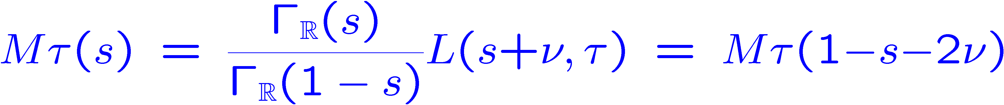
Analytic Continuation of L-functions
GL(2) example: one has (say, for GL(2,Z) automorphic forms)
One computes straightforwardly, term by term, that
which is the functional equation for the standard L-function.
The “archimedean integral” here is s_{R} e(x)|x|^{s-1} sgn(x)^{δ} dx, and (apparently) the only one that occurs in general.
Uniform for holomorphic case º = -(k-1)/2.

Slide 57
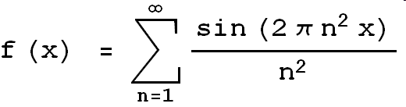
The original example:
Riemann/Weierstrass “Non-differentiable Function”
Historical claim: f(x) is non-differentiable at all real x !
Hardy(1916): proven for almost all x
Gerver (1970) disproven!
        f’(x) = - π for x = 2p/q, p and q odd.

Slide 58
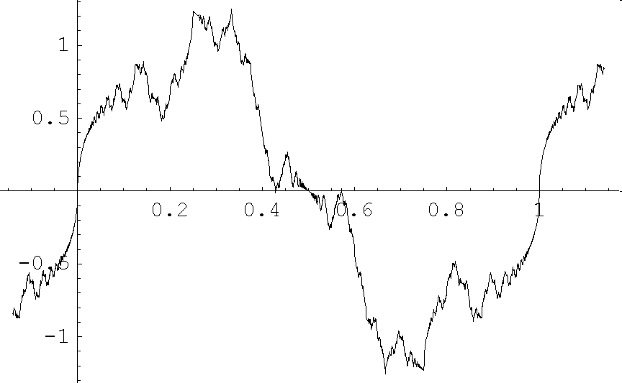
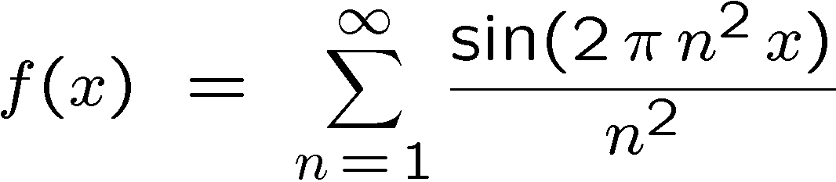
Graph of Riemann’s Function
(Influential in the development of calculus)
Note replication
        (Sidenote) Mandelbrot: The “crisis” caused by this function launched fractals.

Slide 59
What does this have to do with automorphic forms?
f⁰(x) is essentially the θ-function
restricted to the real axis z=x
which exists as an automorphic distribution.
This automorphy explains the replication.
In fact Gerver’s points x=2p/q are the orbit of x=1/2 under Γ₀(4)
and θ is cuspidal in exactly this of the three cusps (0,1/2,∞) of Γ₀(4)\H
θ»1
θ»y^{-1/2}
θ!0

Slide 60
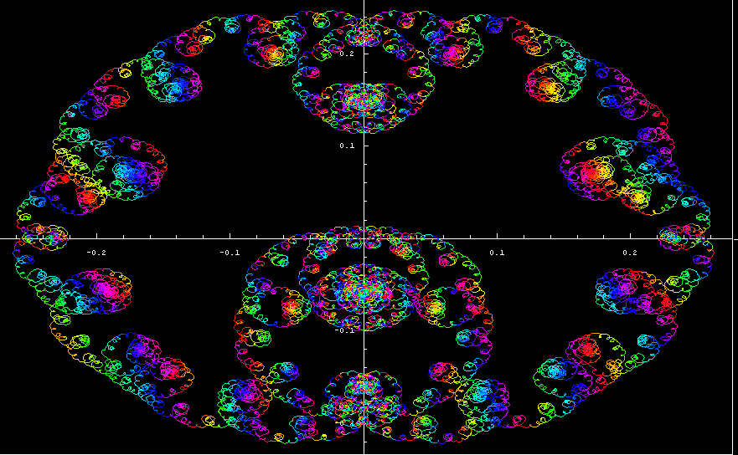
Weight one antiderivative for Gamma_0(23)
This is the image in the complex plane of the antiderivative’s values on the real line

Slide 61
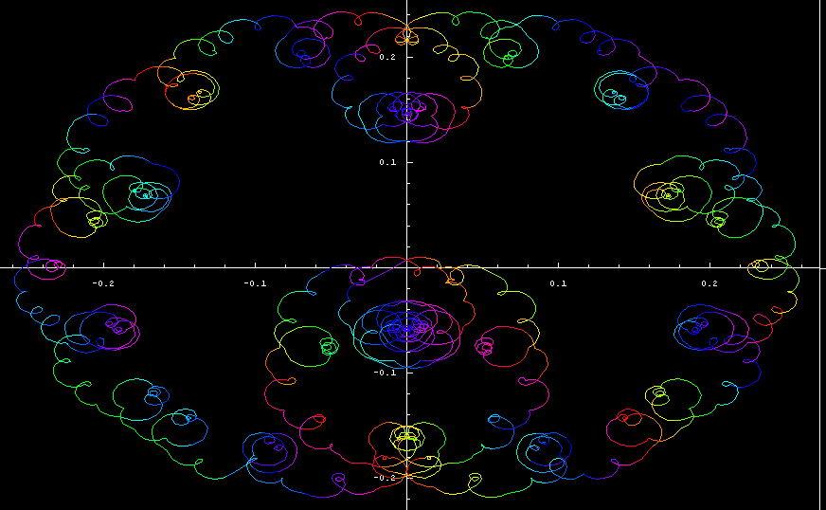
Cruder View

Slide 62
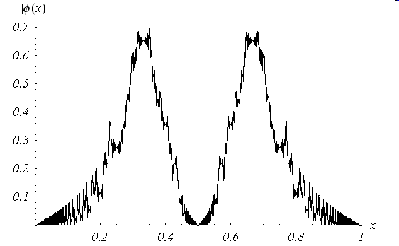
Maass Form Antiderivative
For the first Maass form for GL(2,Z)

Slide 63
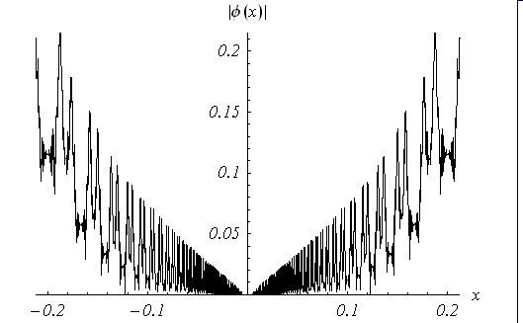
Zoom near origin

Slide 64
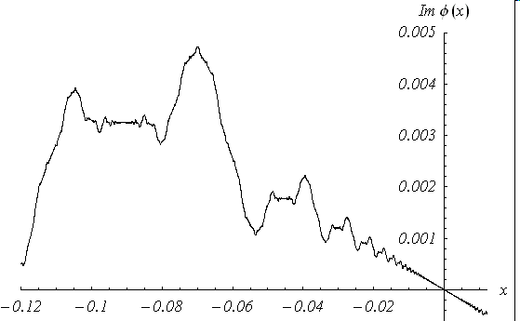

Weight one antiderivative

Slide 65
Regularity Theorem
Recall for a_{n} the coefficients of a modular or Maass form
uniformly in ®.
This almost implies
Theorem (Schmid, 2000): the automorphic distribution ¿ has Holder regularity C ^{– ½ + Re º}.
  This means its first derivative is a continuous function, with Holder index ½+ Re º.

Slide 66
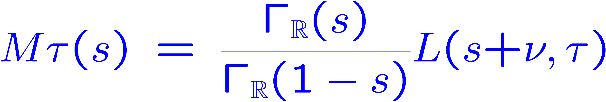
Distributions and integrals of L-functions on critical line
Recall the Mellin transform of the distribution τ(x) = ∑_{n≠ 0} a_{n}|n|^{-ν}e(nx) is
Let ψ be an even, smooth function of compact support on R*. By Parseval
for any σ (integrand is entire, so the contour may be shifted).
If ψ_{ε}(x) is an approximate identity (near x = 1), Mψ(1/2+it) approximates the (normalized) characteristic function of the interval t 2 [-1/ε,1/ε].
One can therefore learn the size of smoothed integrals of Mτ(1/2+it) through properties of the distribution τ(x) near x = 1
  Pictures show it’s small! Cuspidality.
Similarly, the multiplicative convolution τFψ has Mellin transform Mτ(s)*Mψ(s). Its L²-norm approximates the second moment of L(1/2+it), and is determined by the L²-norm of τFψ. The latter is controlled by the size of smooth variants of S(T,x) = ∑_{n·T} a_{n} e(nx).
Conclusion: cancellation in additive sums is related to moments.

Slide 67
Lindelöf conjecture and moment estimates
Lindelöf conjecture: L(1/2+it) = O_{ε}((1+|t|)^{ε}) for any
ε > 0.
  Fundamental unsolved conjecture in analytic number theory.
  Implied by GRH.
  Equivalent to moment bounds:
  s_{-T}^{T} |L(½+it)|^{2k} dt = O_{ε}(T^{1+ε}) for each fixed k ¸ 1.
The 2k-th moment for a cusp form on GL(d) is thought to be exactly as difficult to the 2nd moment on GL(dk).

Slide 68
Bounds on S(T,x) imply bounds on moments
Folklore theorem (known as early as the 60’s by Chandrasekharan, Narasimhan, Selberg):
  If S(T,x) = O_{ε}(T^{β+ε}) for some ½ · β < 1, then
  s_{-T}^{T} |L(½ + it)|² dt = O_{ε}(T^{1 + ε + (2β-1) d}),
    Where d = the degree of the L-function
    E.g. L-function comes from GL(d,A_{Q}).
Thus β = 1/2 is very hard to achieve because it gives the optimal bound O_{ε}(T^{1+ε}).
β = ¾ known for GL(3), but nothing beyond.

Slide 69
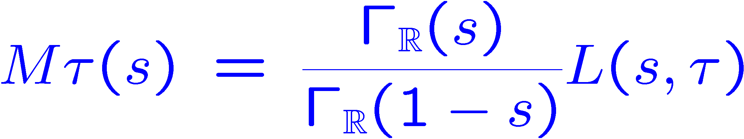
Connection to zeroes on the critical line
Suppose (for fictitious expositional simplicity) ν = 0 for a cusp form on SL(2,Z). It is not difficult to handle arbitrary ν.
Let H(t) = Mτ(1/2+it). Then H(t) = H(-t) is real.
Let ψ_{1/T} be an approximate identity such that Mψ(1/2+it) ¸ 0.
If L(s) has only a finite number of zeroes on the critical line, then the following integral must also be of order T:
But it cannot if τ(x) vanishes to infinite order at x=1 (ψ is concentrated near a point where τ behaves as if it is zero).
In that case this integral decays as O(T^{-N}) for any N > 0!
The above was for a cusp form on SL(2,Z). For congruence groups, the point x=1 changes to q^{½}, q = level. The bound S(T,x) = O_{ε}(T^{1/2+ε}) shows that the last integral is still o(T) with room to spare.
New phenomena: numerically that integral decays only like T^{1/2} for q=11.

Slide 70
GL(n) Principal Series
All representations of G=GL(n,R) embed into principal series representations (π_{λ,δ},V_{λ,δ}):
  V = { f : G! C j f(gb) = f(g) χ⁻¹(b) } , [π(h)f](g) = f(h⁻¹g)
  Here b 2 B = lower triangular Borel subgroup,
  χ(b) = χ_{λ,δ}(b) = ∏ |b_{j}|^{(n+1)/2 - j - λj} sgn(b_{j})^{δj} ,
  and b_{j} are the diagonal elements of the matrix b.
(Casselman-Wallach Theorem) Embedding extends equivariantly to distribution vectors:
V⁻¹ embeds into
V_{λ,δ}⁻¹ = {σ 2 C⁻¹(G) j σ(gb) = σ(g)χ⁻¹(b)}
as a closed subspace.

Slide 71
Another model for Principal Series
Principal series are modeled on sections of line bundles over the flag varieties G/B.
G/B has a dense, open “big Bruhat cell” N = {unit upper triangular matrices}.
Functions in V_{λ,δ}¹ are of course determined by their restriction to this dense cell; distributions, however, are not.
However, automorphic distributions have a large invariance group, so in fact are determined by their restriction to N.
Upshot: instead of studying automorphic forms on a large dimensional space G, we may study distributions on a space N which has < half the dimension. View τ 2 C⁻¹(NÅ ΓnN).
Another positive: no special functions are needed.
A negative: requires dealing with distributions instead of functions, and hence some analytic overhead.

Slide 72
Fourier Series on N(Z)\N(R)
Representation Theory of nilpotent groups gives Fourier expansion:
Expressions related by Poisson summation
  ½’s and ¾’s FTs of each other.
Automorphy relates them to coefficients, as fourier series in 1/x with coefficients c_{n,m} (just like formula for SL(2) ¿).
Integrating these identities also gives a Voronoi-style formula

Slide 73
A Voronoi-style formula for GL(3)
Theorem (Miller-Schmid, 2002) Under the same hypothesis as the GL(2) one, but instead with a_{m,n} the Fourier coefficients of a cusp form on GL(3,Z)nGL(3,R)
for any q > 0 and
The summation formula reflects identities which are satisfied by the various Fourier components.
The theorem can be applied to GL(2) via the symmetric square lift GL(2)! GL(3), giving nonlinear summation formulas (i.e. involving a_{n}²). This formula is used by Sarnak-Watson in their sharp bounds for L⁴-norms of eigenfunctions on SL(2,Z)nH.
Used in the subconvexity result of Xiaoqing Li

Slide 74
L-functions on other groups
Given a collection of automorphic distributions and an ambient group which acts with an open orbit on the product of their (generalized) flag varieties, one can also define a holomorphic pairing.
These pairings can be used to obtain the analytic continuation of L-functions which have not been obtained by the Langlands-Shahidi or Rankin-Selberg methods.
Main example:
  Theorem (Miller-Schmid, 2005). Let F be a cusp form on GL(n), and S any finite set of places containing the ramified nonarchimedean places. Then Langlands partial L-function L_{S}(s,Ext²F) is fully holomorphic, i.e. holomorphic on all of C, except perhaps for simple poles at s = 0 or 1 which occur for well-understood reasons.
In particular, if F is a cuspidal Hecke eigenform on GL(n,Z)nGL(n,R), the completed global L-function Λ(s,Ext² F) is fully holomorphic.
The main new contribution is the archimedean theory, which seems difficult to obtain using the Rankin-Selberg method. Similarly, the Langlands-Shahidi method gives the correct functional equation, but has difficulty eliminating the possibility of poles.

